Slide 1
Biweekly Progress Update
8 Nov 2023

Slide 2
Biweekly Progress Update
20 Sep 2023

Slide 3
Project Title
Exploring CBDCs, Stablecoins, and Purpose-Bound Digital Currency: A Comparative Study and Interactive DApp

Slide 4
PROJECT Description
Create CBDC wallet to:
Use smart contracts to manage transactions efficiently and securely.
Make cross-border transaction by these CBDC (e-Yuan, e-Rupiah etc.) through single mCBDC multi-currency system
Allow users to have their CBDC into the wallet and then use it to make purchases on the e-commerce platforms.
Collect voucher in e-commerce platform as Purpose Bound Money(PBM)
Store rewards by redeeming for vouchers or discounts on participating event as PBM
Notes:
savings, a charity donation, or a particular financial goal
spending, and rewards

Slide 5
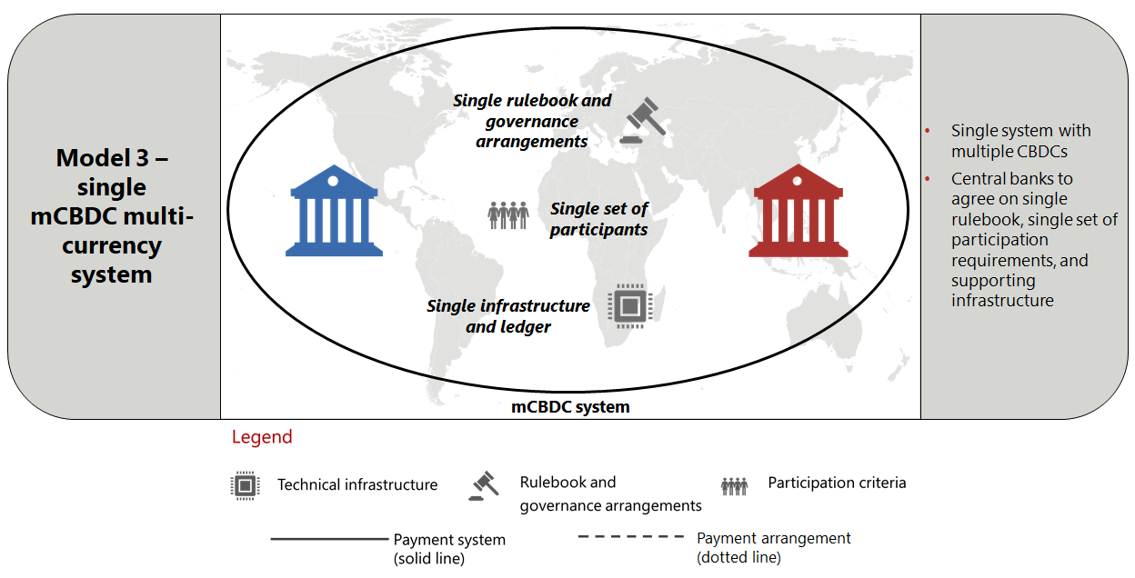
mCBDC Multi-currency system

Slide 6
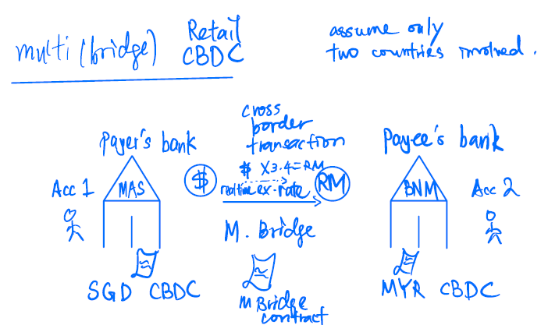

Slide 7
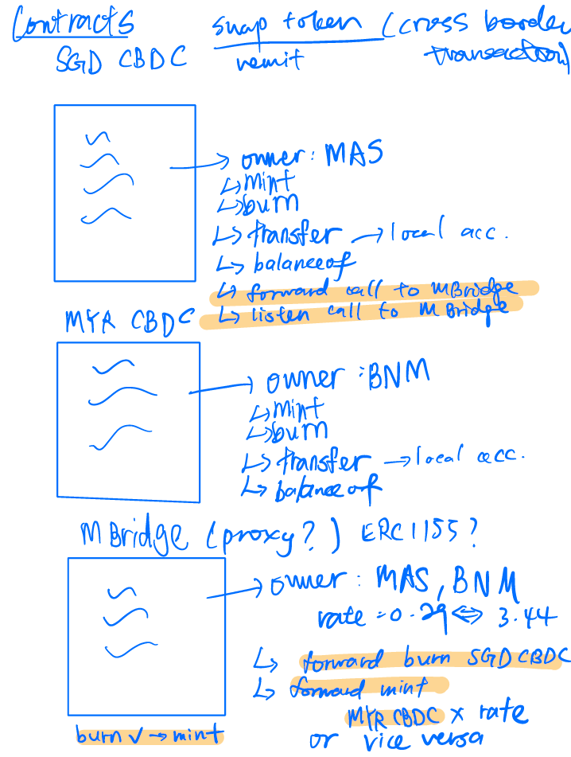
Cross border transaction (CBDC)
E-commerce
(CBDC)
Voucher
(PBM)

Slide 8
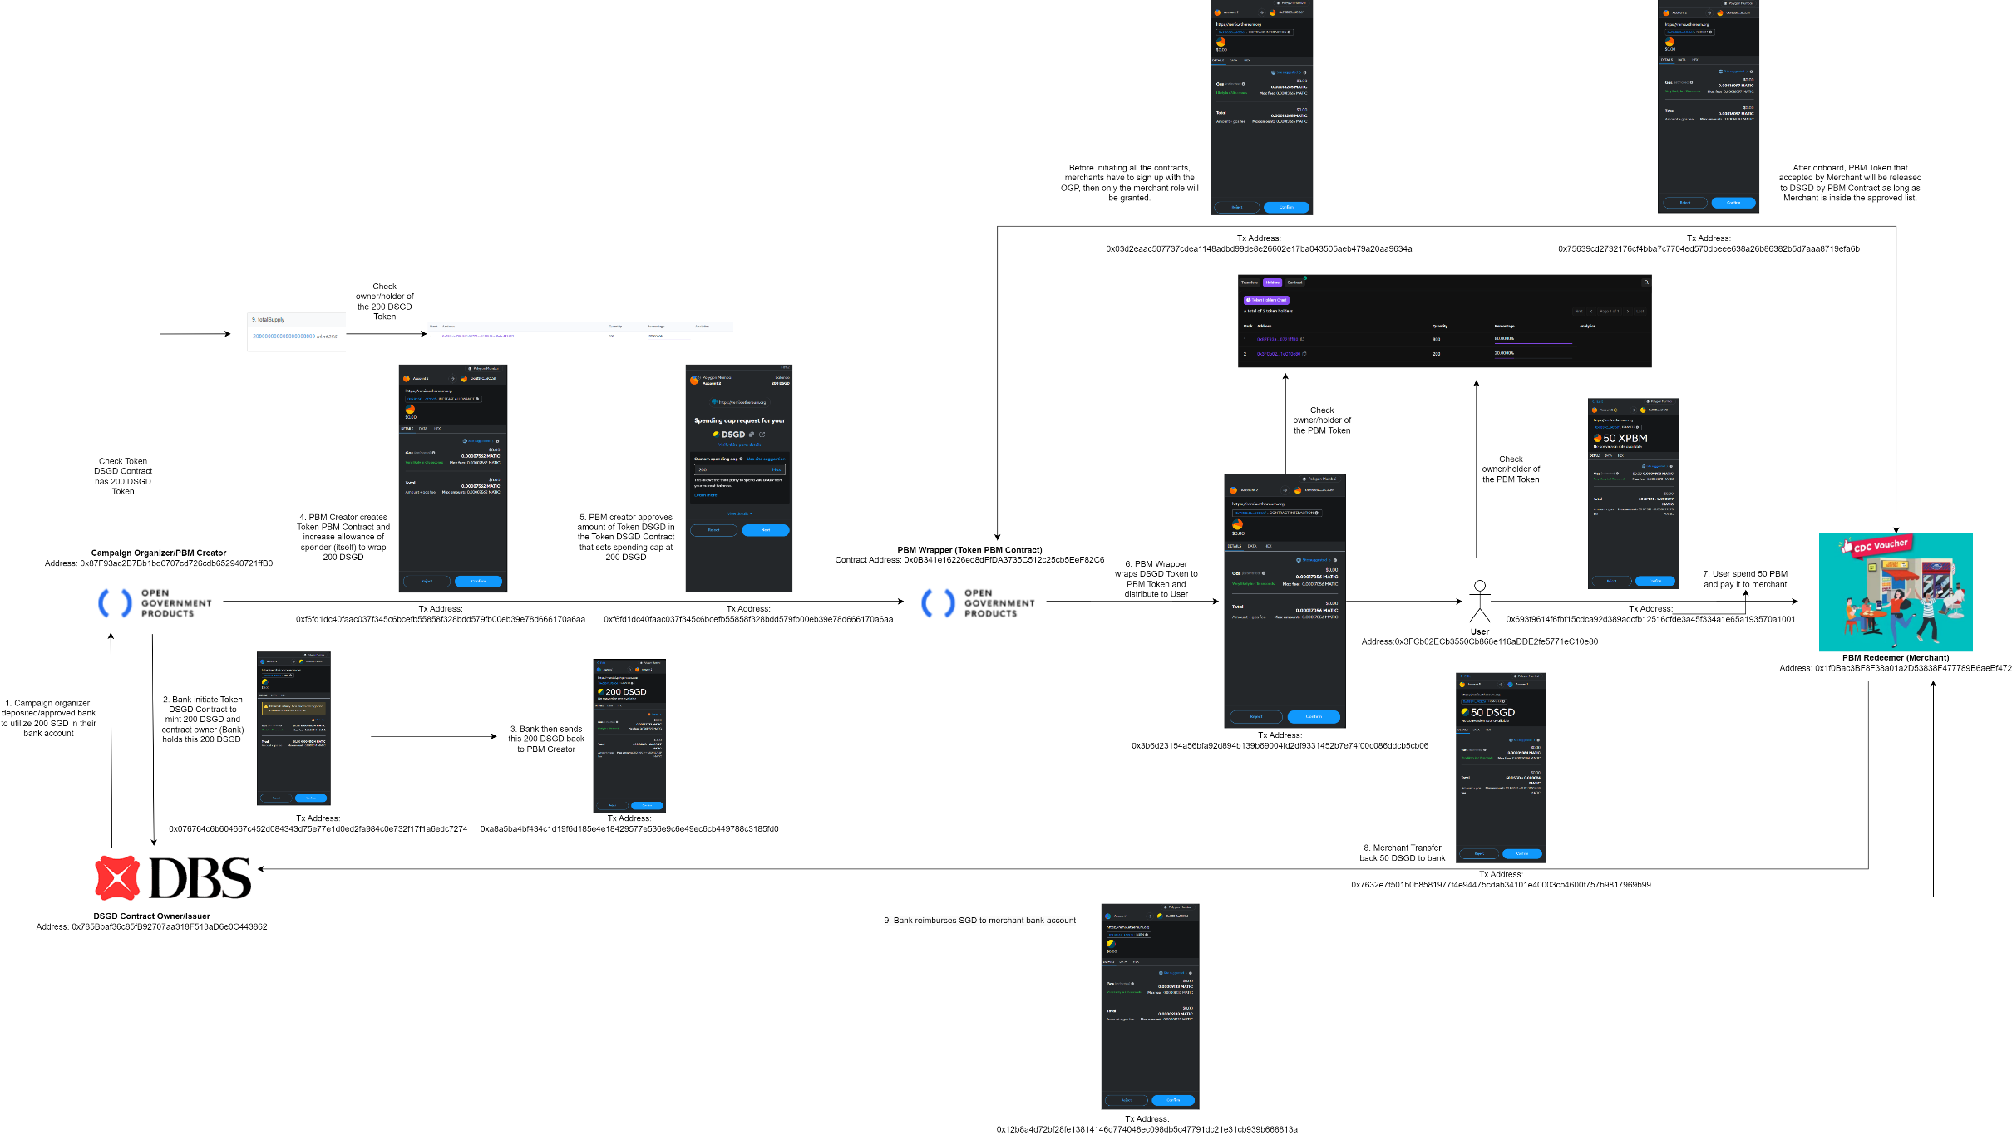
Project Orchid Flow Chart

Slide 9
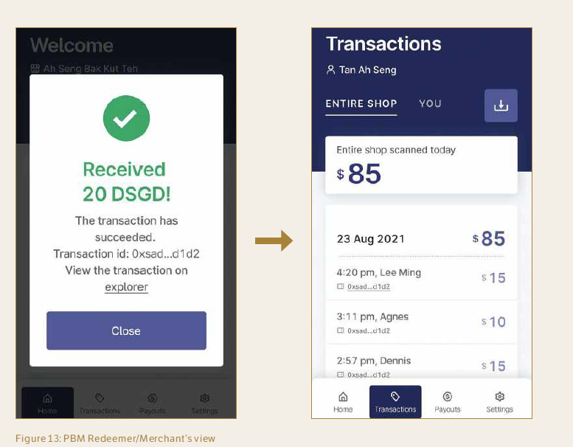
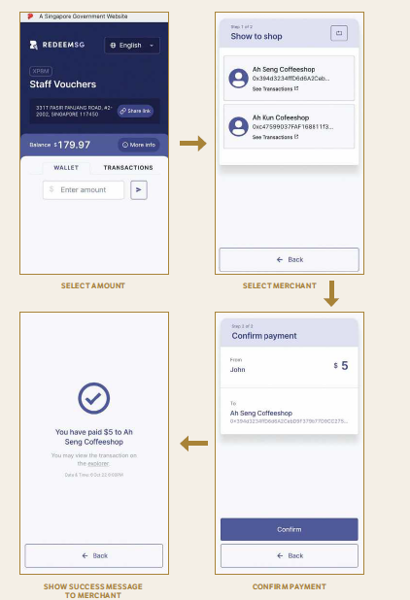
User’s Crypto Wallet
Merchant View

Slide 10
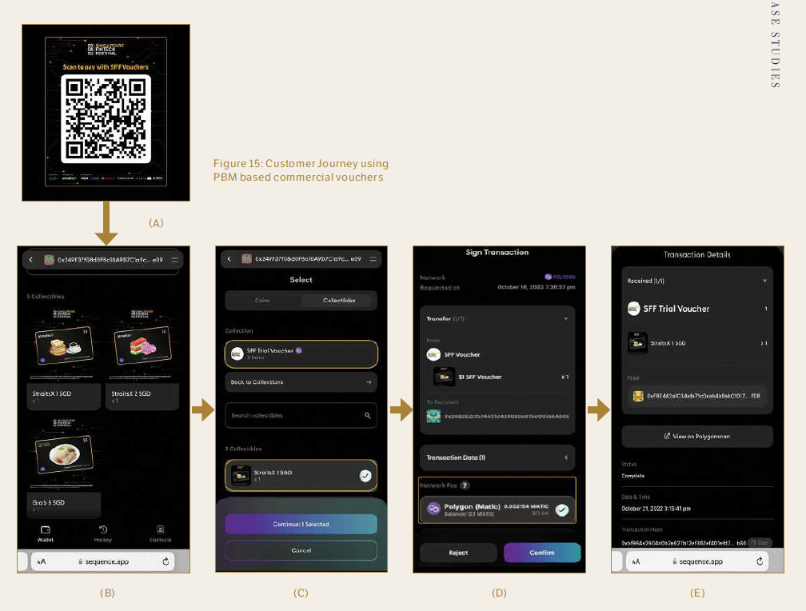
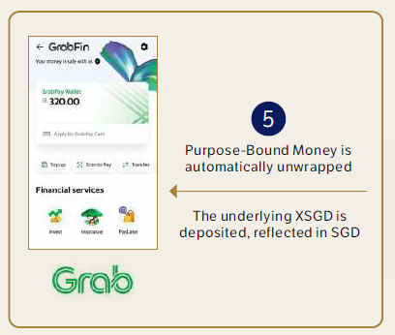
Singapore fintech festival
Notes:
a. Once attendees receive the PBMs,
they can view the PBMs in their
individual wallets.
b. Attendees can open the wallet to
scan the QR code.
c. The attendee selects the PBM to
be used.
d. Attendees review the wallet address,
selected PBM, network fee. Attendees
confirm the transaction.
e. PBM is successfully sent and accepted
into the merchant’s Grab wallet where
it will be automatically unwrapped into
XSGD and reflected in SGD.

Slide 11
Literature review
“Project Orchid.” Schemes and Initiatives. Singapore: Monetary Authority of Singapore, October 31, 2022. https://www.mas.gov.sg/schemes-and-initiatives/project-orchid.
“Purpose Bound Money (PBM) Technical Whitepaper.” Information Papers. Singapore: Monetary Authority of Singapore, June 21, 2023. https://www.mas.gov.sg/-/media/mas-media-library/development/fintech/pbm/pbm-technical-whitepaper.pdf.
Bansal, Rajesh, and Somya Singh. “China’s Digital Yuan: An Alternative to the Dollar-Dominated Financial System,” 40. 1779 Massachusetts Avenue NW Washington, DC 20036: Carnegie Endowment for International Peace, 2021.
Atlantic Council. “Central Bank Digital Currency Tracker.” Accessed September 13, 2023. https://www.atlanticcouncil.org/cbdctracker/.
Karam, Ayman Abi. “Central Bank Digital Currency (CBDC) and Blockchain Enable the Future of Payments.” IBM Blog (blog), August 17, 2023. https://www.ibm.com/blog/central-bank-digital-currency-cbdc-and-blockchain-enable-the-future-of-payments/.
“Project Dunbar - International Settlements Using Multi-CBDCs.” Research & Publication. BIS, Innovation Hub in partnership with the Reserve Bank of Australia, Central Bank of Malaysia, Monetary Authority of Singapore, and South African Reserve Bank, March 22, 2022. https://www.bis.org/publ/othp47.htm.
Chan, Elgin. “Renminbi Internationalisation: China’s Central Bank Digital Currency,” 2023. https://dr.ntu.edu.sg/handle/10356/165508

Slide 12
News and video
https://www.youtube.com/watch?v=Qrx_FnjRnfI
https://www.youtube.com/watch?v=9aXFeOsKndE&pp=ygUOY2JkYyBzaW5nYXBvcmU%3D
https://www.youtube.com/watch?v=PNkdlRPamPs&t=22s&pp=ygUOY2JkYyBzaW5nYXBvcmU%3D
https://youtu.be/Qrx_FnjRnfIrx_FnjRnfI (no English Subs)

Slide 13
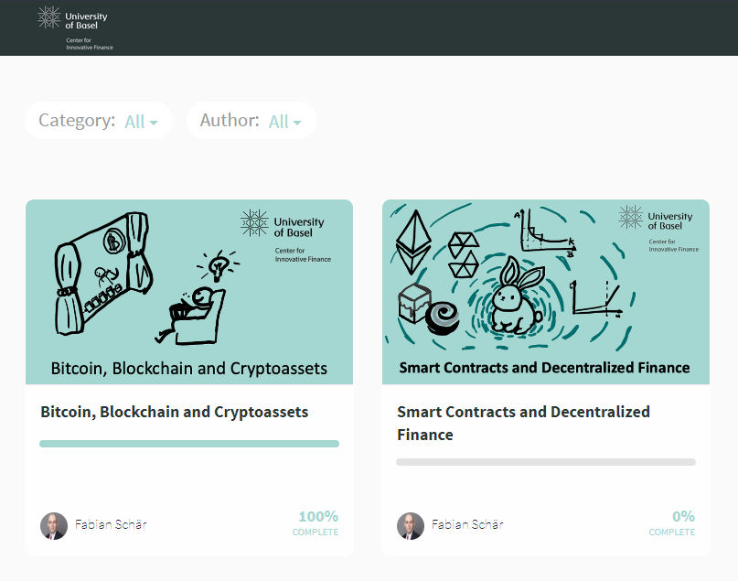
Learning
University of Basel
Bitcoin, Blockchain and Cryptoassets
Smart Contracts and Decentralized Finance
Notes:
Introduction
Welcome to the Class!
Monetary Theory Basics
Payment Systems
Monetary Control Structures
Bitcoin Primer
Transaction Capacity
Peer-to-Peer Networks
The Bitcoin Network
Introduction to Cryptography
Hash Functions
Symmetric Cryptography
Asymmetric Cryptography
Elliptic Curves and ECDSA
Exercise Set 1
Transaction Legitimacy
Transaction Overview
Bitcoin Script and Transaction Types
SigHash Types
Transaction Consensus
Block Assembly and Chain Structure
Proof-of-Work
Fork Theory
Incentives and Potential Attacks
Alternative Consensus Protocols
Exercise Set 2
Graded Exercise Set
Bitcoin as Money
The History of Digital Money
Pricing Models and Volatility
CBDCs and Stablecoins

Slide 14
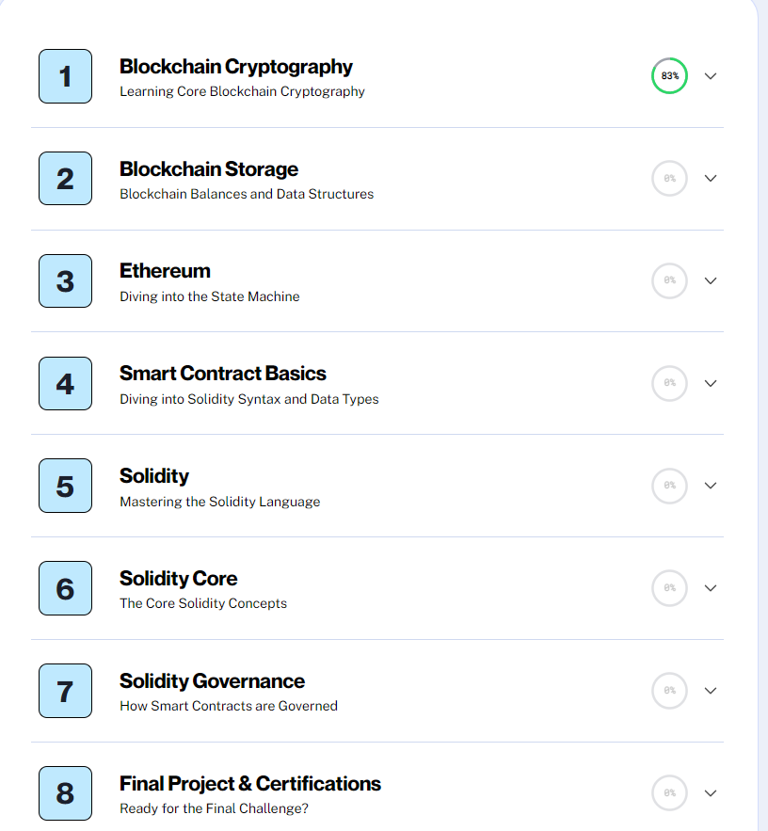
Learning
Alchemy University

Slide 15
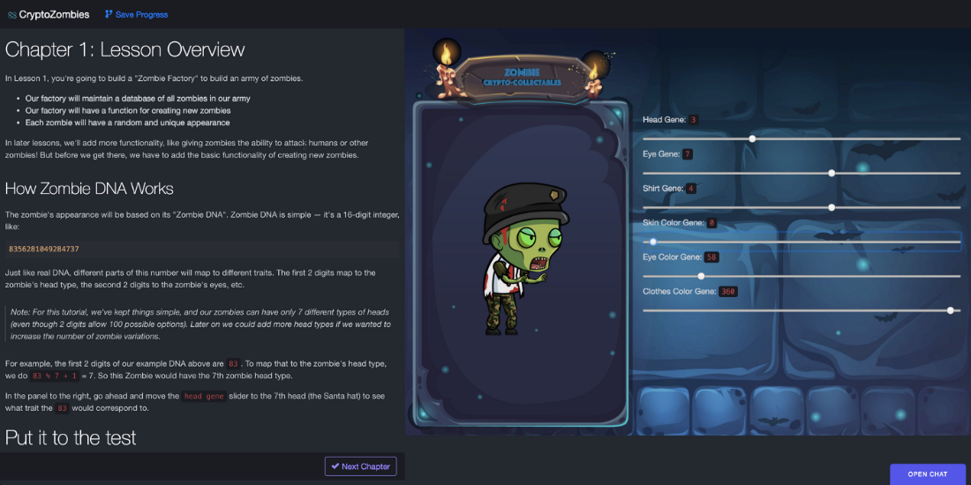

Learning
Crptozombies.io
Solidity: Beginner to Intermediate Smart Contracts
Advanced Solidity: Get In-depth Knowledge
Beyond Ethereum: Explore the Blockchain Ecosystem

Slide 16
Other useful resources
https://www.tutorialspoint.com/solidity/solidity_constructors.htm
https://docs.alchemy.com/docs/create-web3-dapp-quickstart
https://trufflesuite.com/guides/nft-rental-marketplace/
https://blog.cabala.co/how-i-set-up-my-local-solidity-development-environment-with-vscode-remix-and-truffle-suite-addd20ef9c
https://www.mas.gov.sg/-/media/mas/news/media-releases/2023/mas-stablecoin-regulatory-framework-infographic.pdf
https://github.com/norges-bank
https://github.com/Consensys/codefi-assets-and-payments
https://www3.ntu.edu.sg/home/ehchua/programming/blockchain/ethereum.html
https://github.com/codyseibert/web3-tickets

Slide 17
Thank you!

Slide 18
Biweekly Progress Update
25 Oct 2023

Slide 19
Project Title
Exploring CBDCs, Stablecoins, and Purpose-Bound Digital Currency: A Comparative Study and Interactive DApp

Slide 20
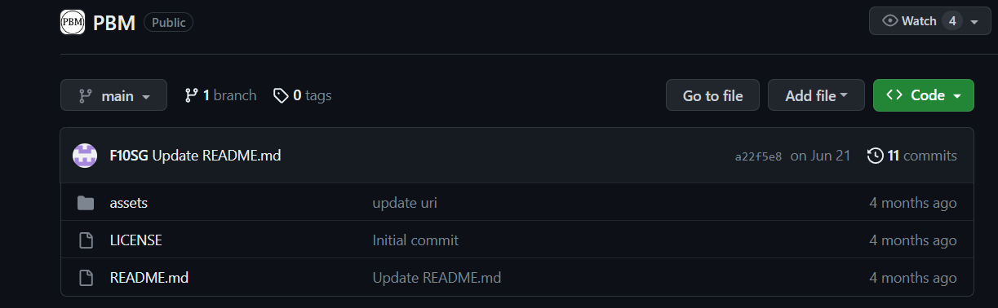
STUDY PBM Code Repo

Slide 21
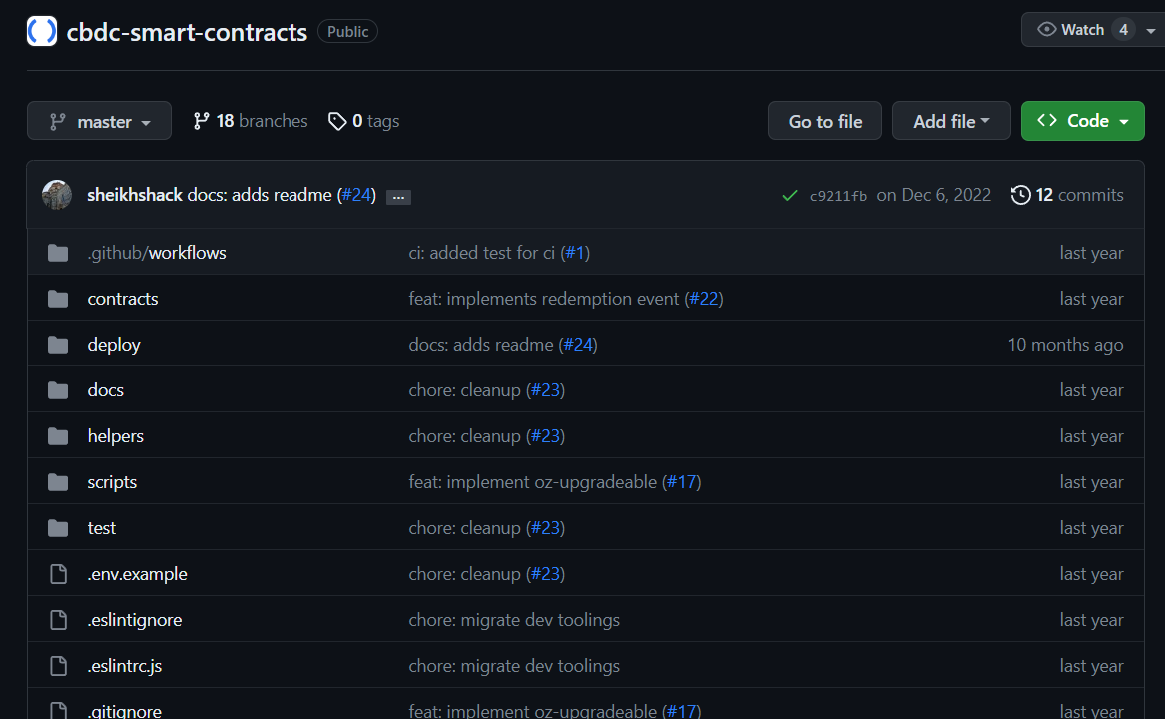
STUDY Project orchid Code Repo

Slide 22
Problem statement & Goal

Slide 23
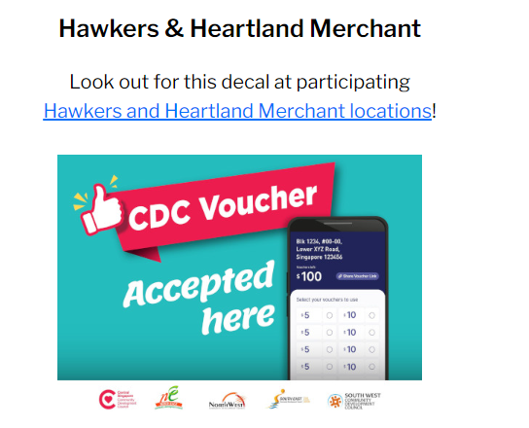
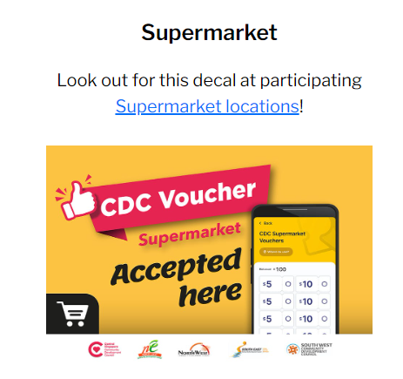
Problem/Motivations
High cost of implementing voucher schemes
High cost of contracting for each scheme
Settlement processing is slow and costly
Article: How we built an inclusive digital voucher system for the Singapore government
Notes:
High cost of implementing voucher schemes & contracting for each scheme
Campaign Organisers would need to work out from scratch a host of implementation details. They would need to figure out, how the system works. When there’s a new voucher scheme, the agency needs to reach out to each merchant to onboard them to the scheme and the merchant still needs to sign a separate contract as the voucher conditions and issuer are different.
Settlement processing is slow and costly
Hawkers waited for weeks or months before they got reimbursed.
Staff had to go from shop to shop to collect the vouchers, count them, tally each shops’ earnings and type in their paper records.

Slide 24
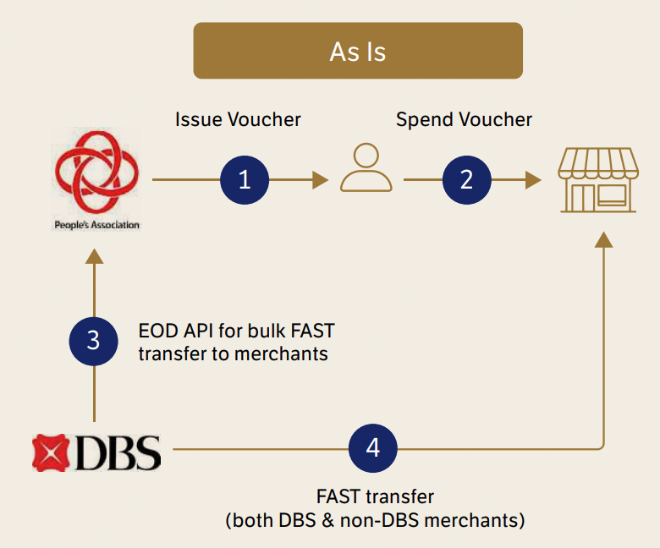
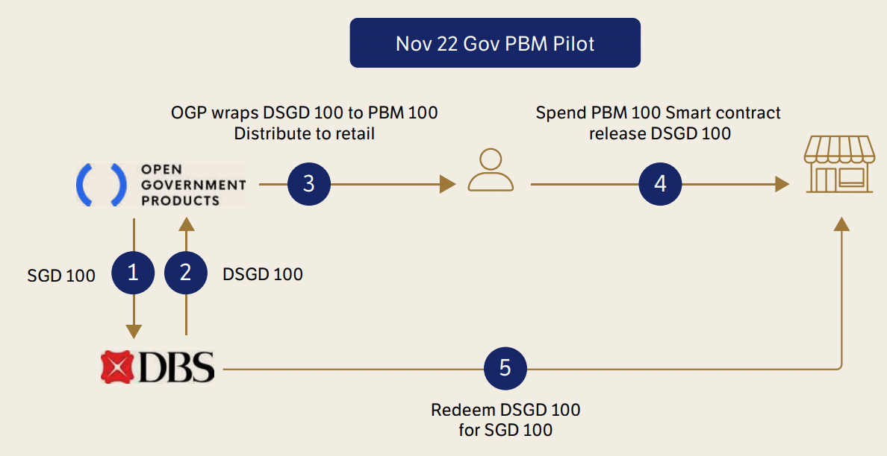
Goal
Flexible on creating or improving voucher system
Eliminate voucher issuer’s default risk
Automate the settlement process, faster payout
Less work means less cost = efficient
No paper = digital
Notes:
1. PBM Creator (Organizers) deposits SGD funds that is intended to be used with the DSGD issuer
2. DSGD Issuer proceeds to mint the digital SGD based on the funds sent by the PBM Creator.
3. ODP wraps DSGD with the logic, DSGD->PBM
3. PBM Holder(recipient) onboard and receives voucher
4. They spend the PBM and it will release back to DSGD when merchant received
5. Once campaign ended, DSGD will be transferred back to DSGD issuer and burnt, so that it can be redeemed back to SGD and transfer back to merchant

Slide 25
Technical design

Slide 26
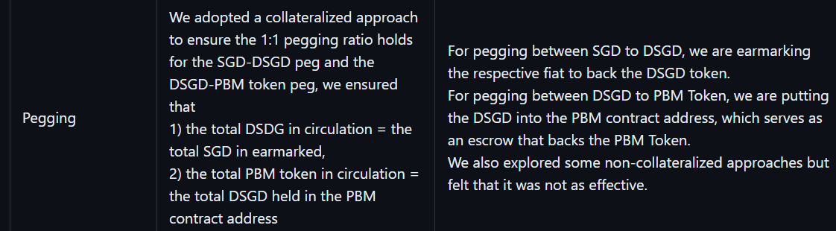
Smart Contracts
Digital SGD Contract (DSGD) - A contract for the DSGD token that maintains all the DSGD related logic. To act as a raw underlying token
PBM Contract - A contract for managing the PBM tokens. PBM tokens are essentially wrapped DSGD tokens, where purpose logic is wrapped on the underlying DSGD token.

Slide 27
ERC20 Token for CBDC Contract
Fungible token
Any one token is exactly equal to any other token; no tokens have special rights or behavior associated with them
Medium of exchange currency, voting rights, staking, and more

Slide 28
Inheritance Of solidity
To inherit the properties and methods of one interface or contract to another, similar to how interface can be extended in TypeScript or other languages
IS keyword is used to inherit in Solidity
Must implement all the functions declared in the interface IF inherit from INTERFACE

Slide 29
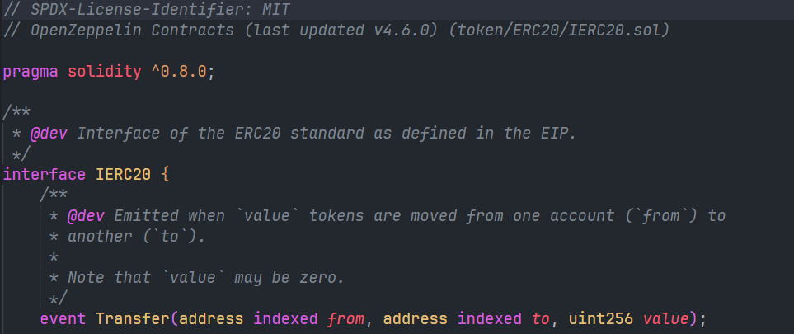
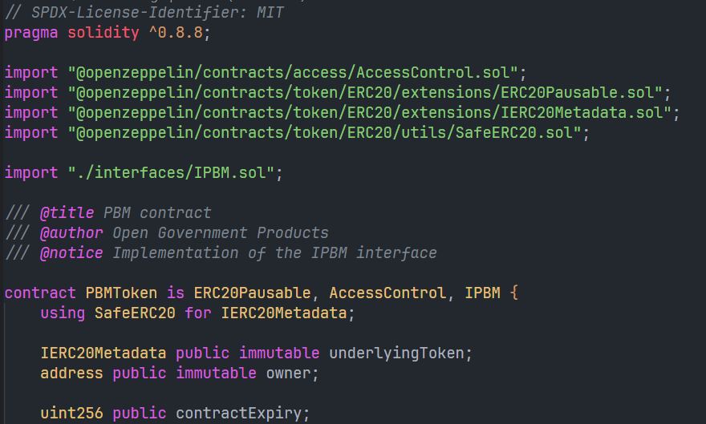
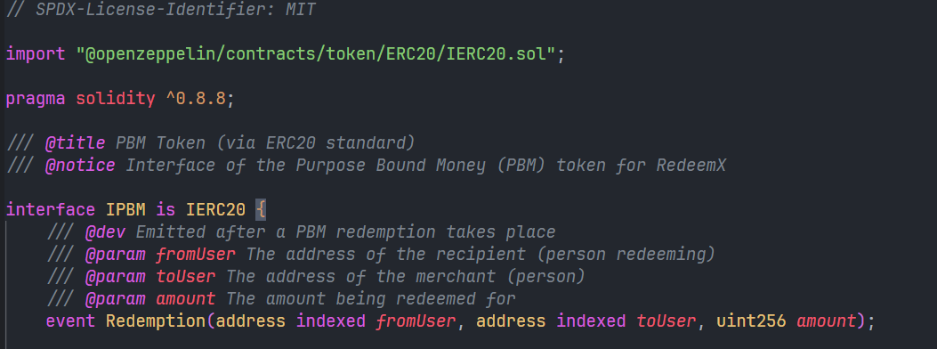
Openzeppelin contract

Slide 30
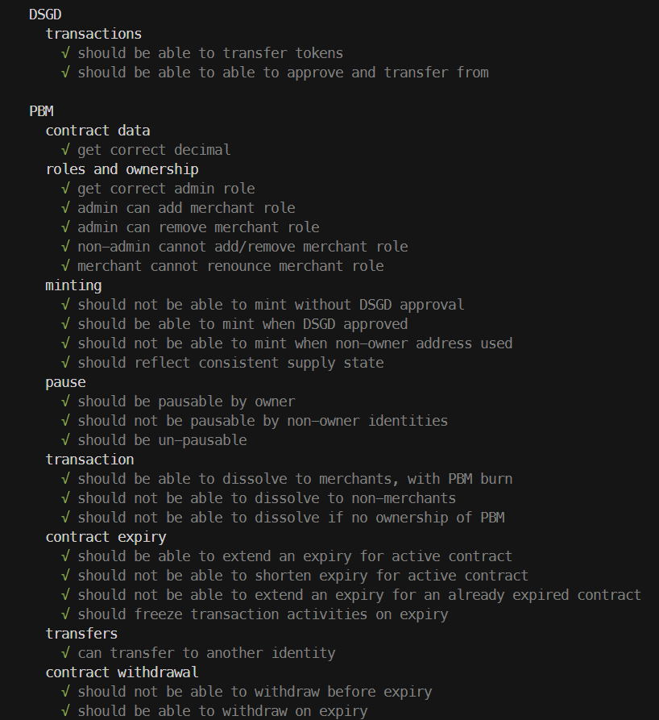
Tools stack
Backend Framework
Testing Frameworks
Use Hardhat to deploy in local during development phase
In staging phase, deploy in Polygon Mumbai Testnet
Mocha + Chai (Local)
Waffle matchers (Local)
RemixIDE (Testnet)

Slide 31
PBM demo

Slide 32
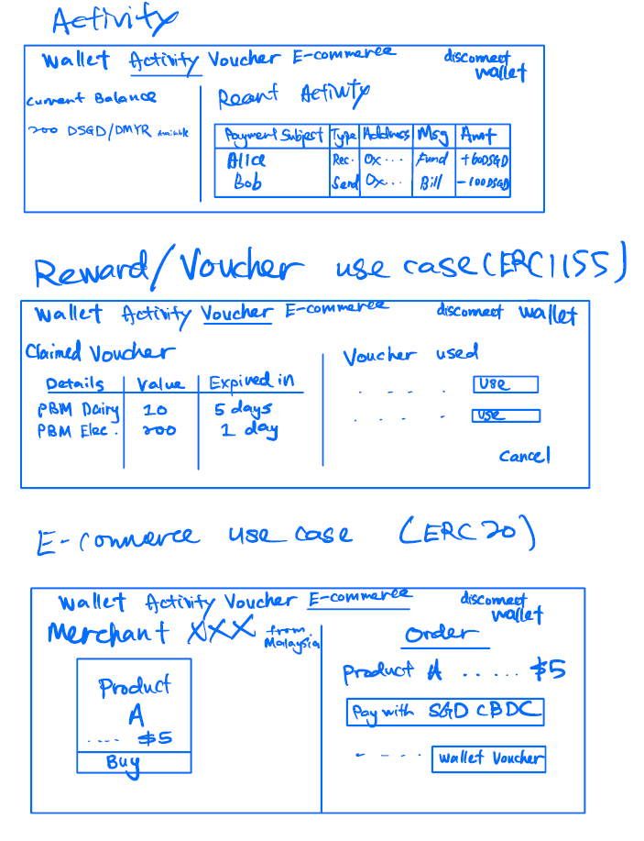
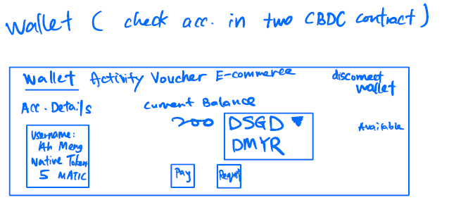
Wireframe

Slide 33
Local payment demo

Slide 34
Thank you!

